Slide 1
IT- 4201 Human Computer Interaction
Lecture # - 2

Slide 2
Contents
Design Improvement of Hardware and Software components
HCI Disciplines
HCI’s impact on society
HCI’s impact on culture
HCI’s impact on economy
Where should I fit knowing HCI?
HCI professional Roles
Activity/Assignment

Slide 3
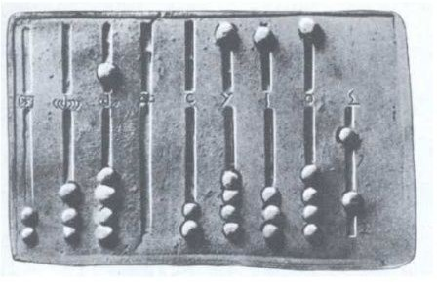
Calculating devices in antiquity
The abacus (plural abaci or abacuses), also called a counting frame, is a calculating tool which has been used since ancient times.
It was the first calculating device that improved about 5000 years ago by the Chinese educationists.
It was used in the ancient Near East, Europe, China, and Russia, centuries before the adoption of the Hindu-Arabic numeral system.

Slide 4
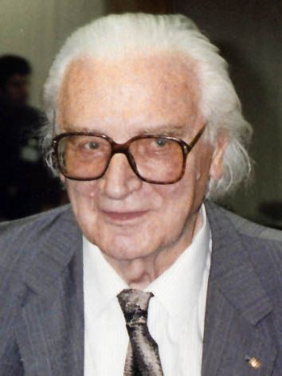
Konrad Zuse (1910-1995)
Invented the world’s first programmable computer (in 1941)
This remained the only working computer in Europe up to 1951

Slide 5
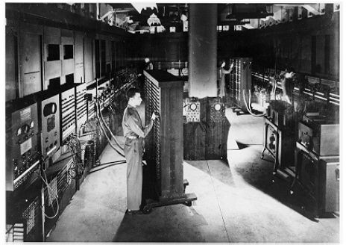
ENIAC (~1946)
First electronic numerical integrator and computer in the US.
Construction contract was signed in 1943.
The first programmers of the ENIAC were six women (“Refrigerator Ladies”).

Slide 6
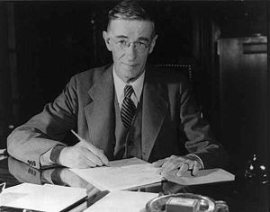
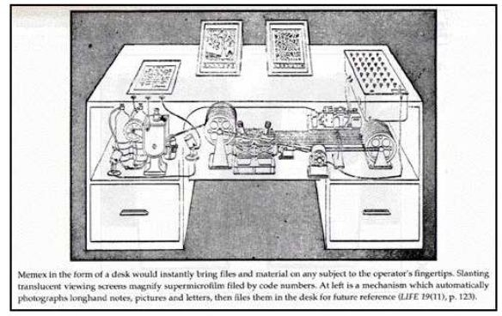
Memex (1945)
Vannevar Bush was an American engineer, inventor and science administrator, who during World War II headed the U.S. Office of Scientific Research and Development (OSRD), through which almost all wartime military R&D was carried out, including important developments in radar and the initiation and early administration of the Manhattan Project.
Memex is a conceptual data storage and retrieval system outlined by Vannevar Bush.

Slide 7

Memex (1945) cont.
“wholly new forms of encyclopedias will appear, ready made with a mesh of associative trails running through them…”

Slide 8
Memex (1945) cont.
“If the user wishes to consult a certain book, he taps its code on the keyboard…”
“Frequently-used codes are mnemonic, so that he seldom consults his code book;”
“He can add marginal notes and comments … even … by a stylus scheme”
“All this is conventional…”

Slide 9
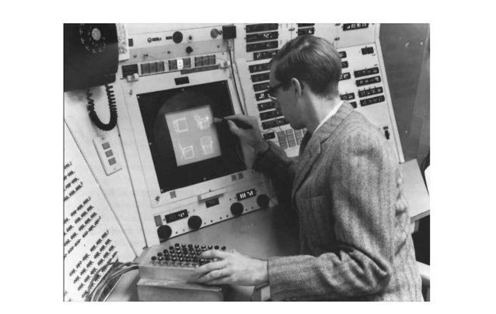
SketchPad by Ivan Sutherland
At MIT (1963)

Slide 10
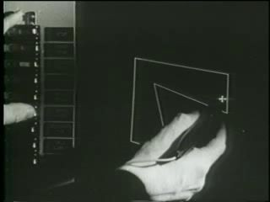
SketchPad by Ivan Sutherland (cont.)

Slide 11
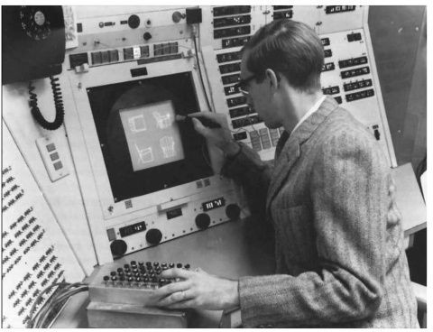
SketchPad by Ivan Sutherland (cont.)
Direct manipulation of objects
SketchPad paved the way for the Graphical User Interface
Sutherland’s PhD thesis also defined the terms “objects” and “instance”.
SketchPad is the first object-oriented programming system.

Slide 12
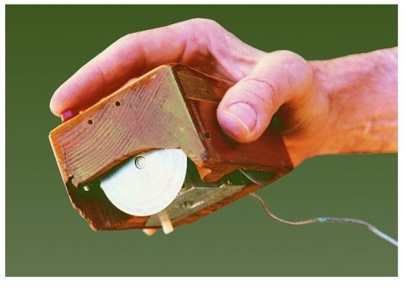
https://www.slideshare.net/agaszostek/history-and-future-of-human-computer-interaction-hci-and-interaction-design

Slide 13
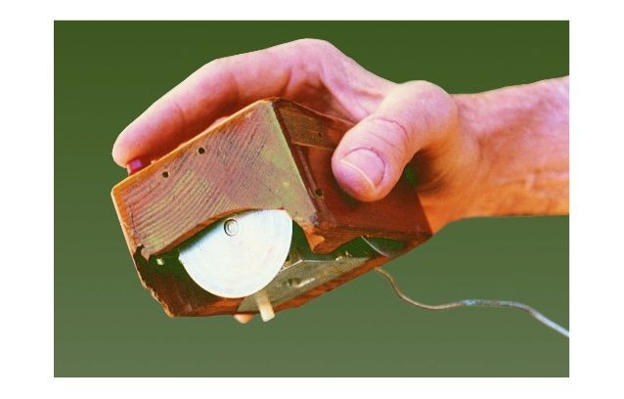
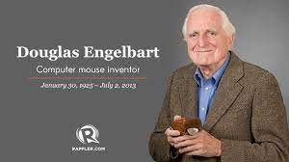
First mouse by Engelbard at Stanford (1963)

Slide 14
Nothing eventful happened in the next 10 years…

Slide 15
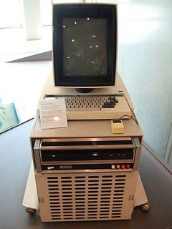
Xerox Alto (1973)
It is a computer designed from its inception to support an operating system based on a graphical user interface, later using the desktop metaphor.

Slide 16
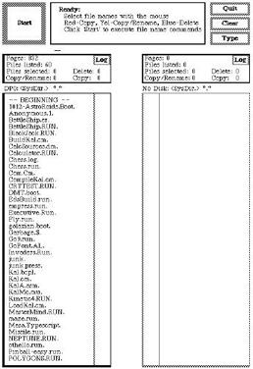
Xerox Alto (1973) (cont.)

Slide 17
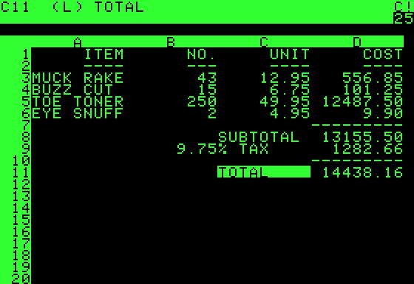
VisiCalc (1979)

Slide 18
VisiCalc was the Killer App for Personal Computers
Turned the microcomputer from a hobby for nerds into a serious thing.
Because of it, IBM introduced the IBM PC.
2 years later suddenly, small and large business bought computers

Slide 19
With the emergence of personal computing in the late 1970s, everyone became a potential computer user…
… but computer users still had to deal with arcane commands and system dialogs

Slide 20
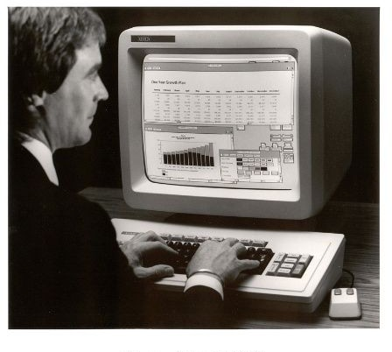
Xerox Star (1981)

Slide 21
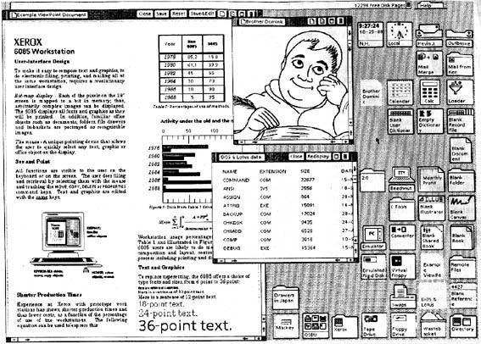
Xerox Star (1981) (cont.)

Slide 22
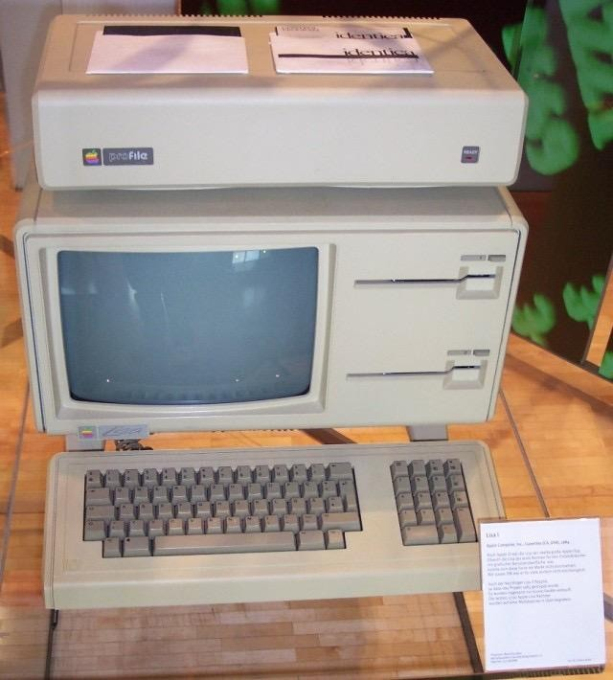
Apple Lisa (1981)

Slide 23
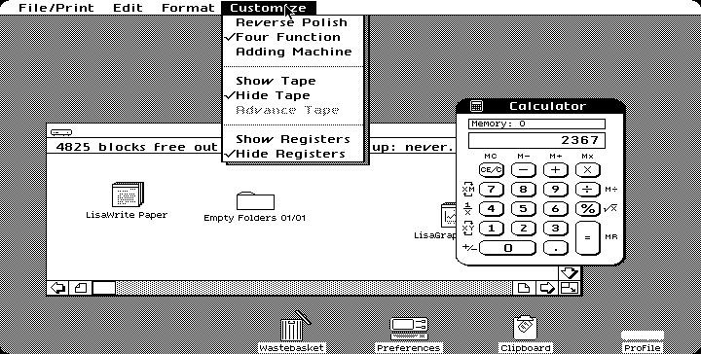
Apple Lisa (1981) (cont.)

Slide 24
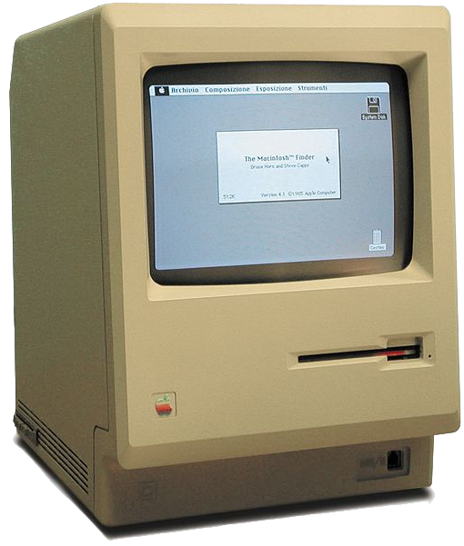
Apple Mac (1984)

Slide 25
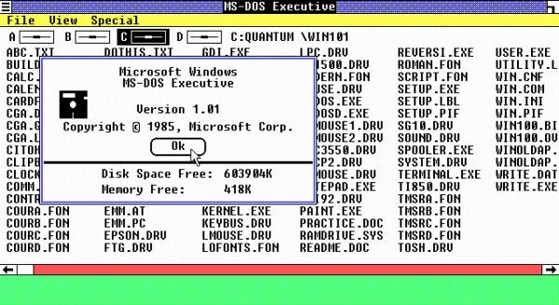
Windows 1.0 (1985)

Slide 26
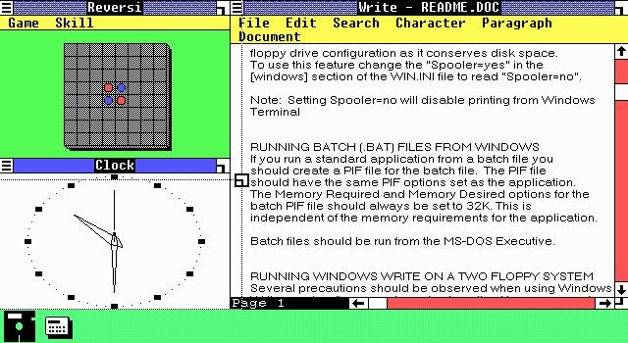
Windows 1.0 (1985) (cont.)

Slide 27
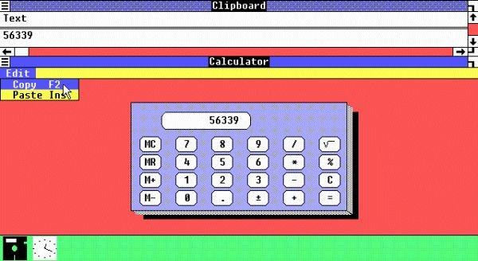
Windows 1.0 (1985) (cont.)

Slide 28
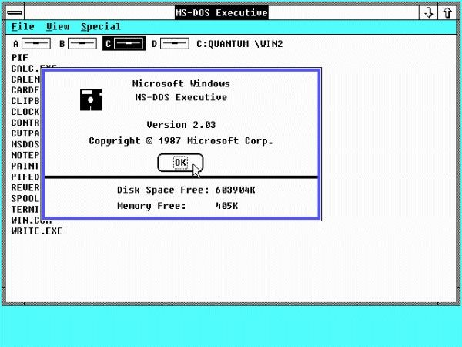
Windows 2.0 (1987)

Slide 29
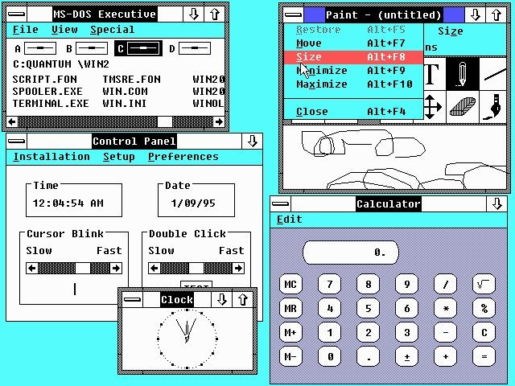
Windows 2.0 (1987) (cont.)

Slide 30
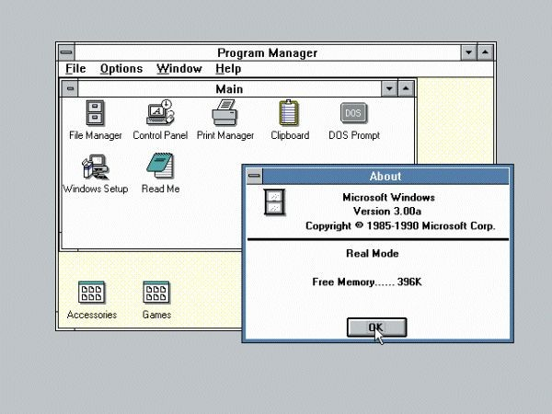
Windows 3.0 (1990) (cont.)

Slide 31
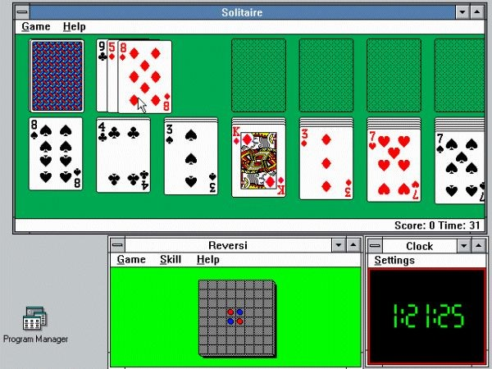
Windows 3.0 (1990) (cont.)

Slide 32

World Wide Web (1990)
https://www.slideshare.net/agaszostek/history-and-future-of-human-computer-interaction-hci-and-interaction-design

Slide 33
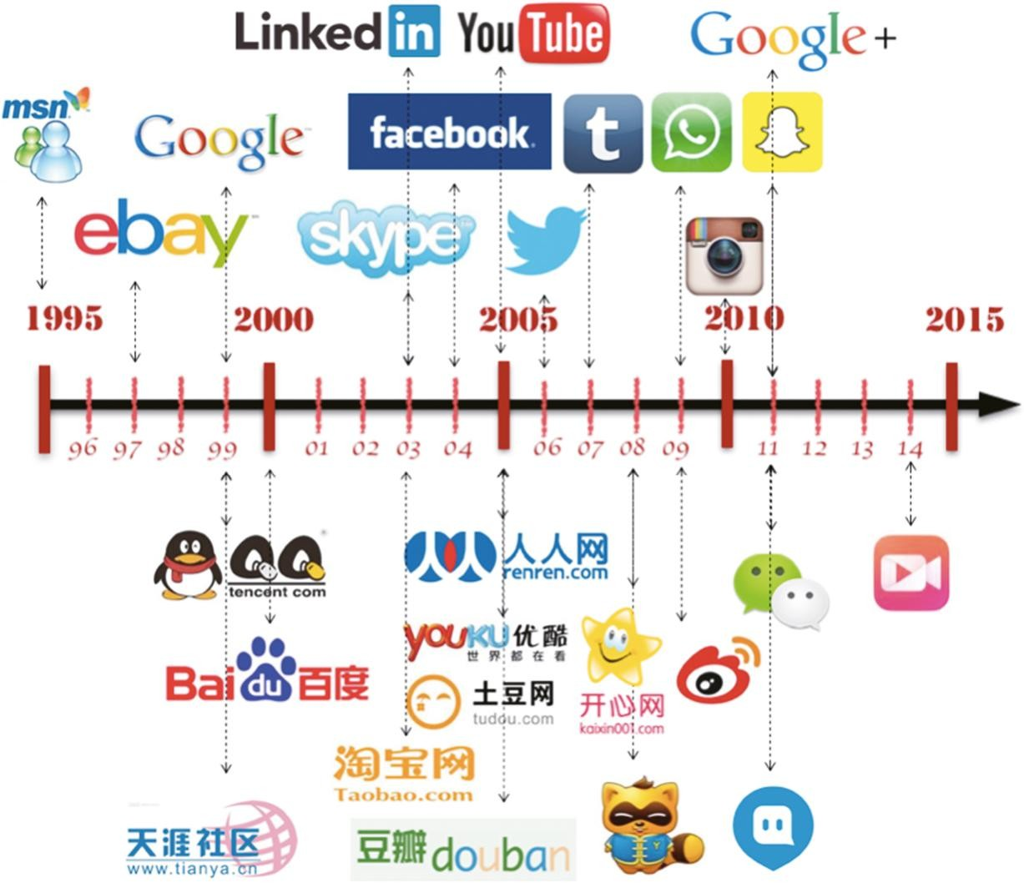
https://ucldigitalpress.co.uk/Book/Article/17/42/1216/

Slide 34
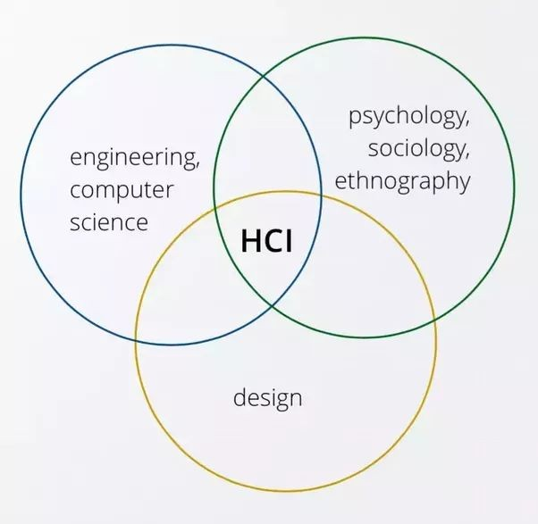
HCI Disciplines
"HCI is concerned with understanding the influence technology has on how people think, value, feel, and relate and using this understanding to inform technology design." Wright & McCarthy (2008)

Slide 35
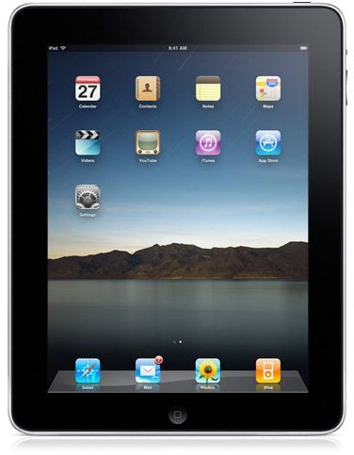
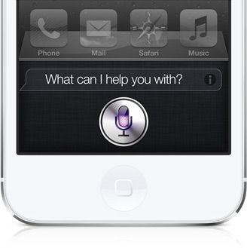
HCI’s impact on society
We can now use computers as an every-moment- partner
Less and less training is required for most application and devices
Some examples
Touch screen: direct interaction with objects
Voice control: for some people the only way to interact with computers

Slide 36
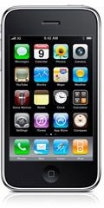
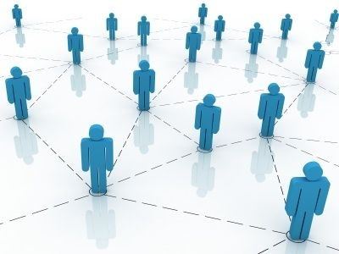
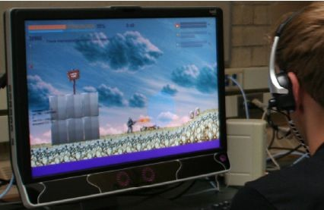
HCI’s impact on culture
Smartphones have changed how we spend our "empty times": should we read the news? answer emails? chat with friends? play "2 Dots"? should we just be bored?
Social Media have influenced how we stay in touch with each other and how find new friends and lovers.
Games, more than entertainment, can be used as social and even productive tools.

Slide 37
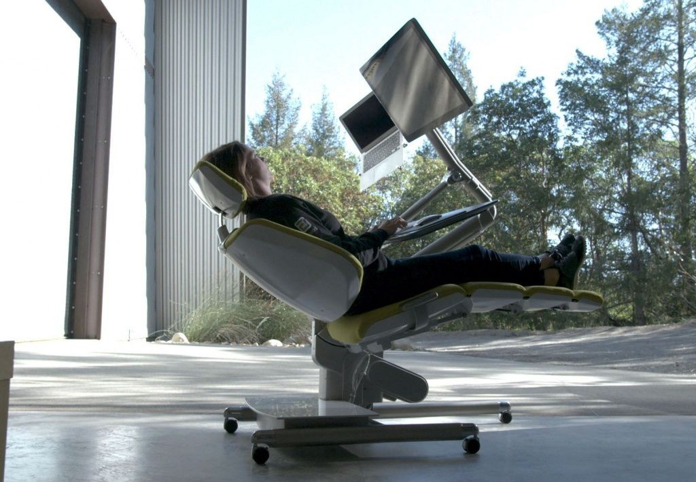
HCI’s impact on economy
Massive increase in productivity
HCI found how to speed up input and reduce its complexity People can perform tasks faster than they used to
Reduced need for training
More people can use technology than ever before

Slide 38
What now???

Slide 39
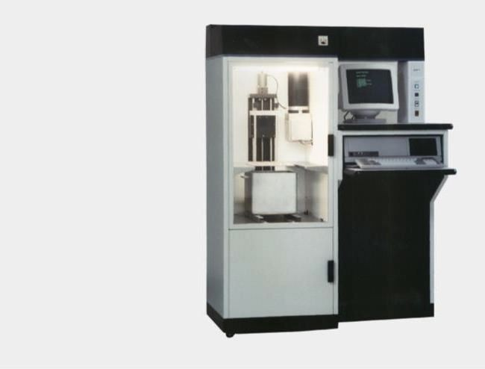
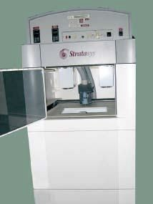
Fabrication (3D Printing) in HCI
1992
The first commercial FDM printer 3D Modeler by Stratasys, Inc.
Invented by Scott & Lisa Crump
1987
The first commercial 3D printer SLA-1 printer by 3D Systems Inc. Invented by Charles Hull
“The idea for the technology came to Crump in 1988 when he decided to make a toy frog for his young daughter using a glue gun loaded with a mixture of polyethylene and candle wax. He thought of creating the shape layer by layer and of a way to automate the process. In April 1992, Stratasys sold its first product, the 3D Modeler.”

Slide 40

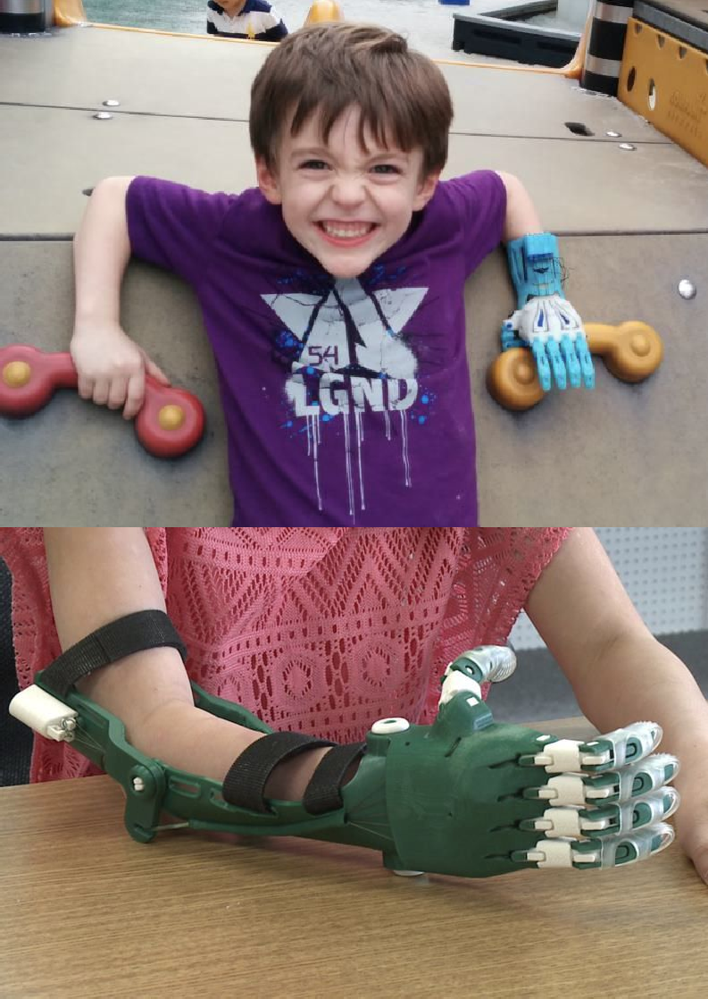
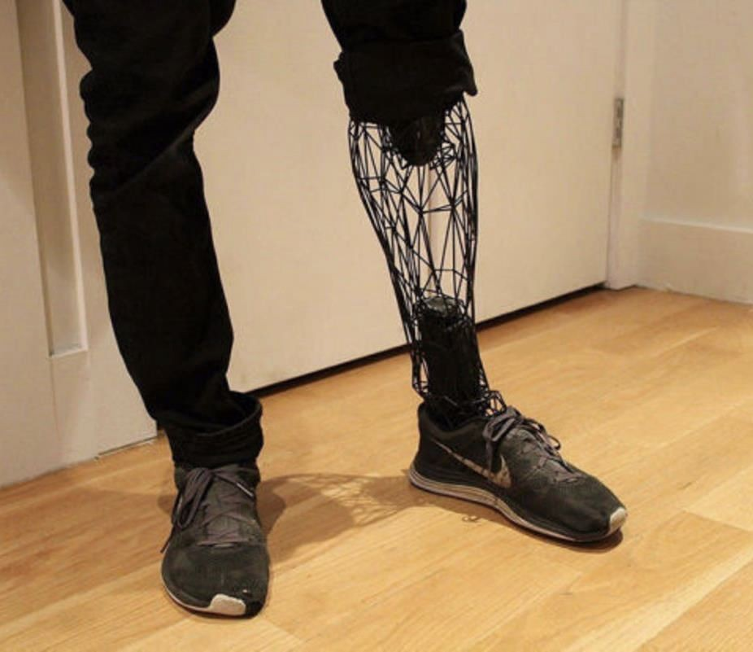

Slide 41
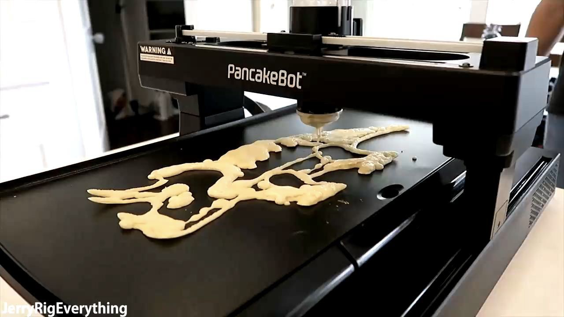
3D Printing pancakes using FDM (Fused deposition modeling)

Slide 42
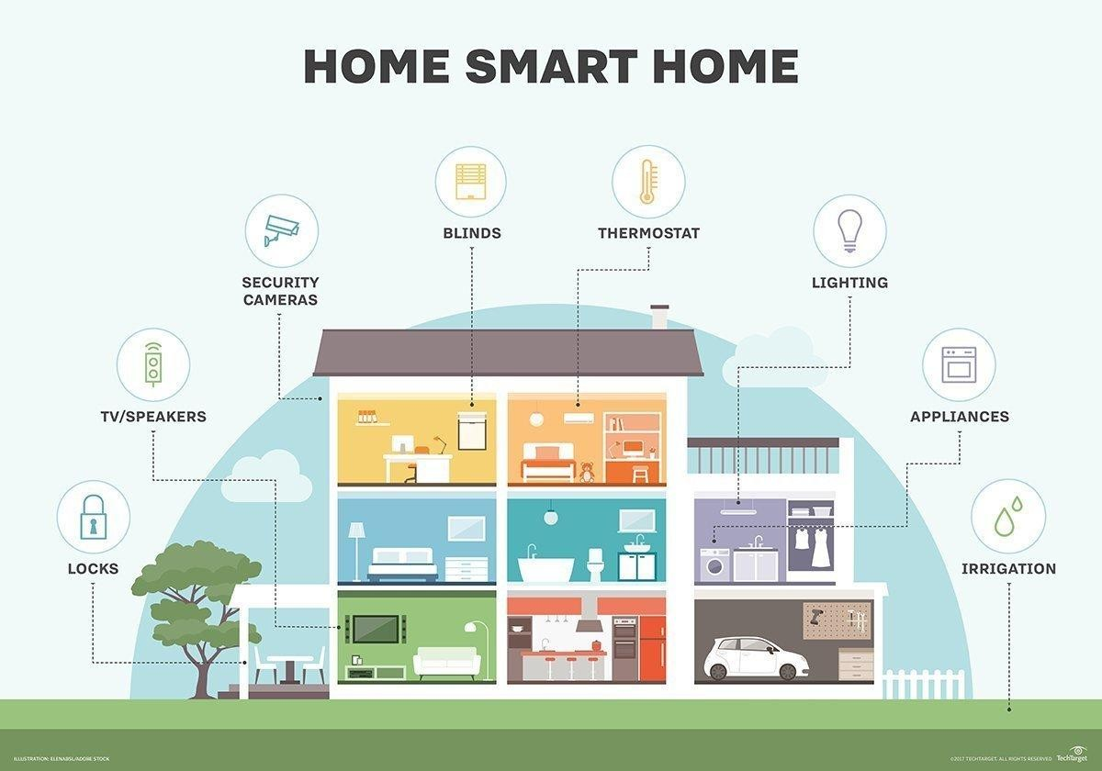
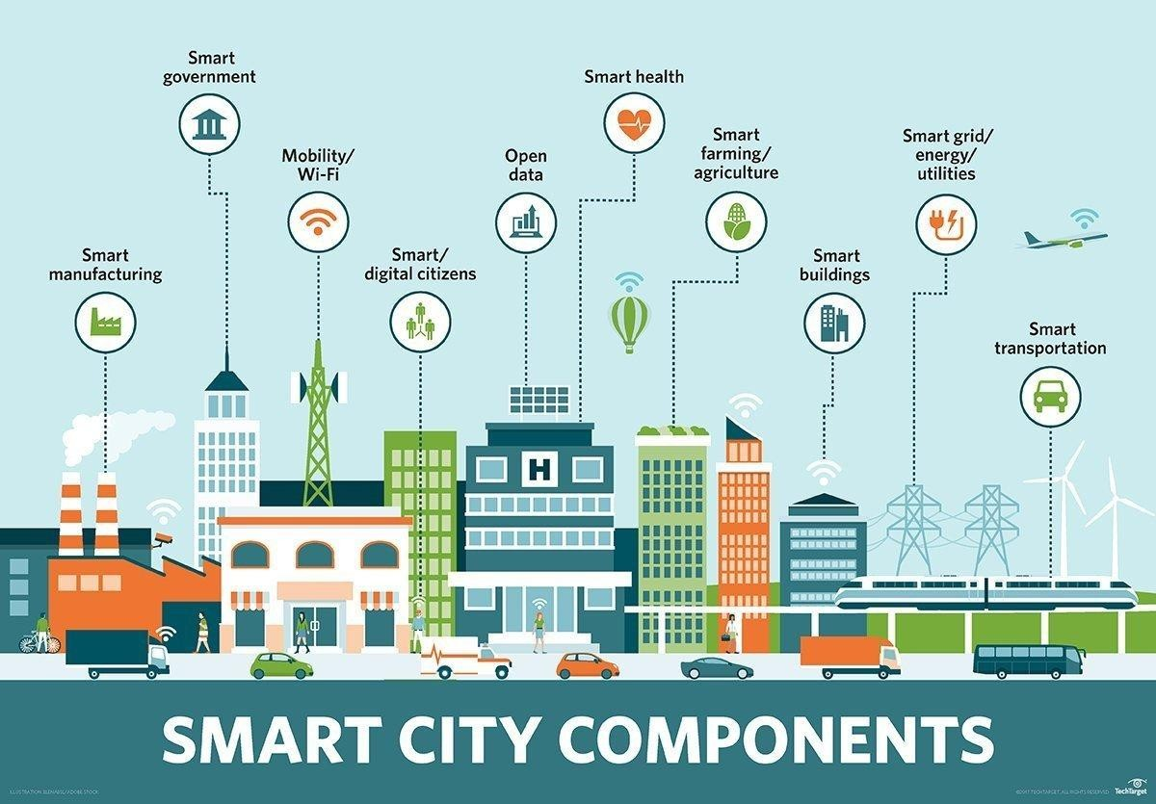
Society as the next platform

Slide 43
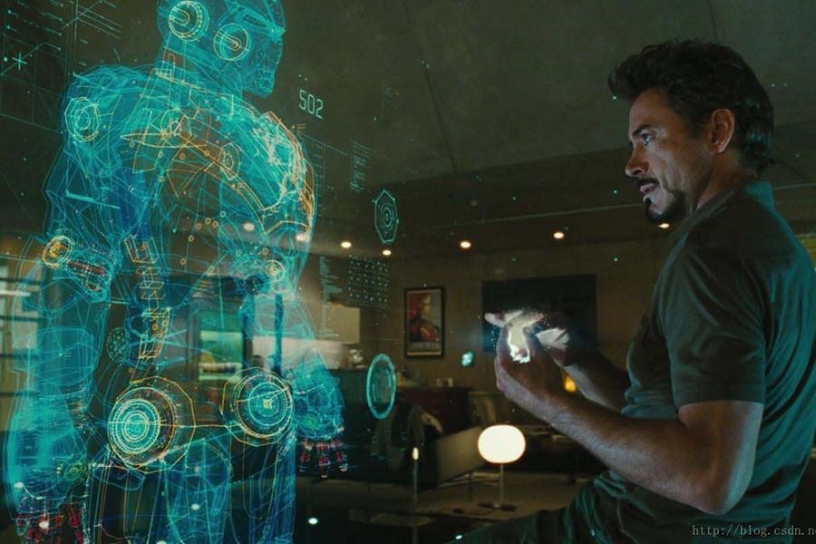
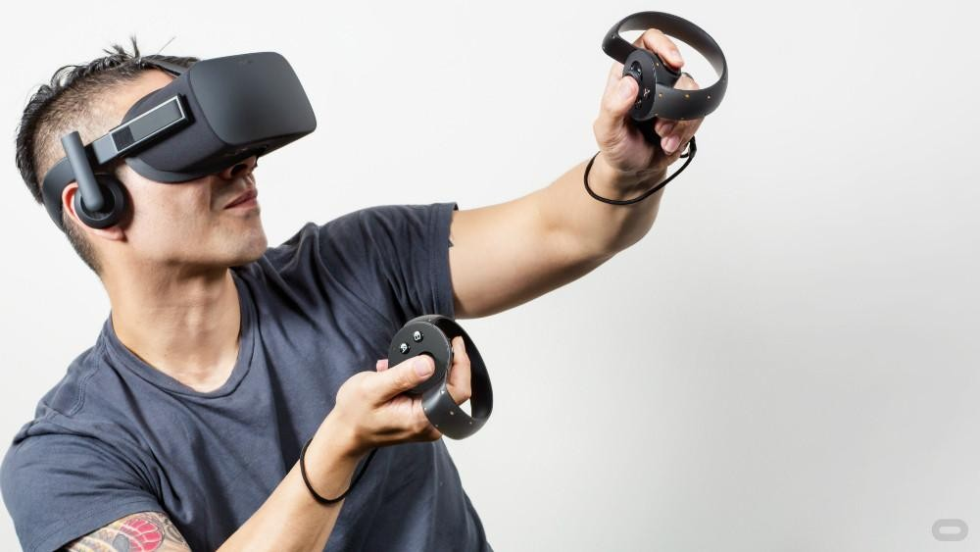
And beyond (VR/AR)

Slide 44
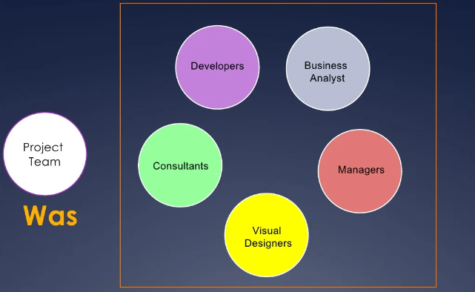
Where should I fit knowing HCI?

Slide 45
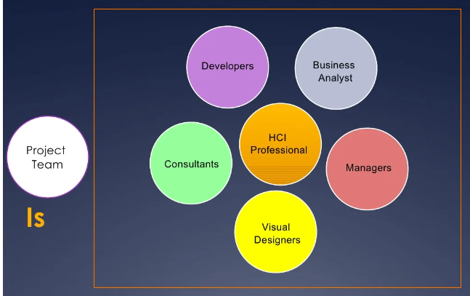
Where should I fit knowing HCI? (cont.)

Slide 46
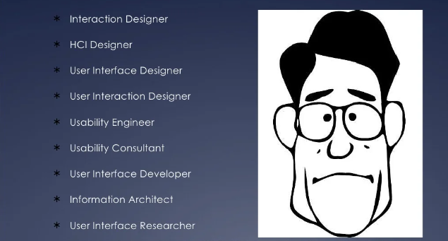
HCI Professional Roles

Slide 47
Activity/Assignment

Slide 48

Activity (10 minutes)
How would you change this thing? Make sure your idea is innovative!
Sketch out your design on a piece of paper and write your names on it
(this time we will collect it :) )

Slide 49
Reflection
What did you come up with?
What were the challenges?

Slide 50
Thank You

